Slide 1
The Zen of Coding
Day 1
March 2, 2017

Slide 2

Introduce Yourselves!
Name
Location
Background (Career, Education, Interests)
Why learn web development?
Fears about class?

Slide 3

Instructor = … ?
Jim McCoy
BS in IT from the University of Houston
Self-taught web developer
Freelancing since 1999
LOVES teaching
Deep love of hobbies but without any time to pursue.

Slide 4
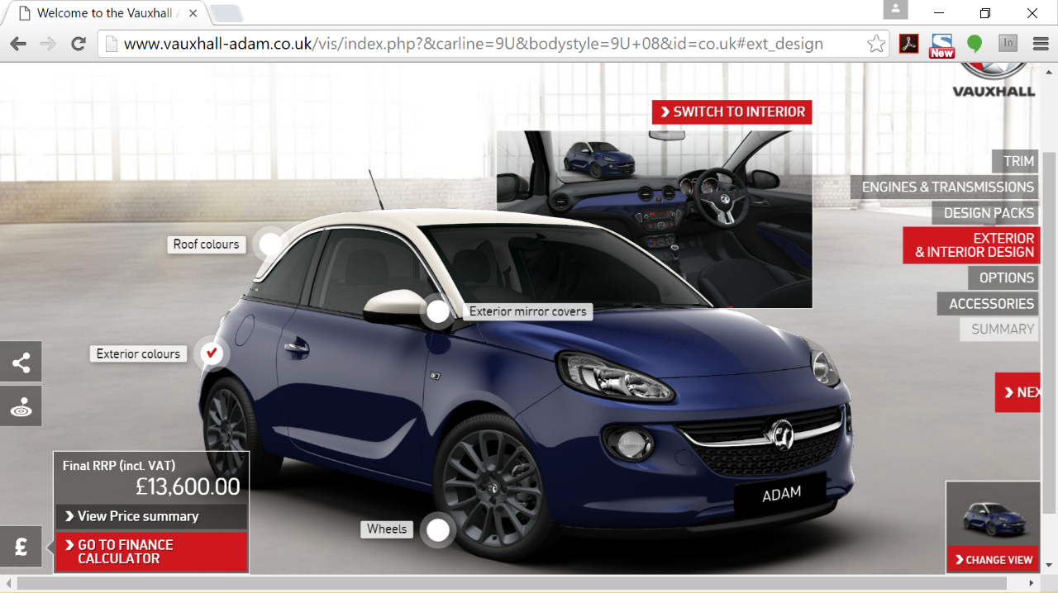
Some Cool Stuff I Made…

Slide 5
The Path of Learning

Slide 6
Common Student Goals
“To land a solid career.. and be able to support a family.”
“Hope to make something of myself one day…”
“An opportunity to be more creative in my day-to-day work.”
“…to get a better paying job.”
“I want nothing more in the entire world than to be a game designer.”
“Change careers and become a web developer.”
“…to build mastery. To learn a skill that I haven’t yet explored.”
“[a chapter] better than the last.”

Slide 7
Your Goal = Our Goal
As instructors,
We take your goals very, very seriously.

Slide 8
Support Team
Our Promise:
If you’re willing to put in the time – and you take our advice, we’re here to help you 100% of the way.
This goes for everyone working behind the program:
Instructors
TAs
Student Success Team
Career Coaches
Everyone Else…

Slide 9
Nothing Comes Easy…
As students, you face two HUGE obstacles

Slide 10
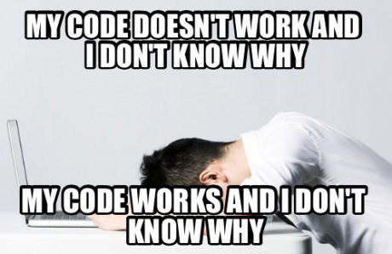
Obstacle #1 – The Great Confusion

Slide 11
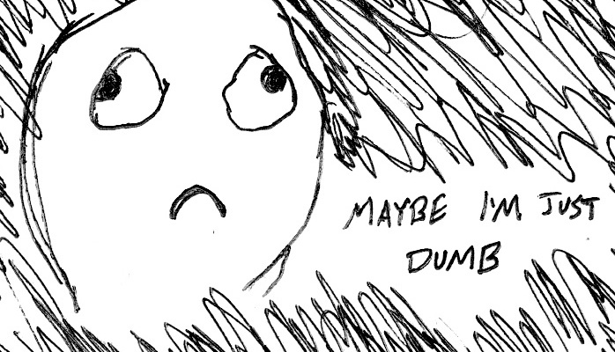
Obstacle #2 – The Great Doubt

Slide 12
Nothing Comes Easy…
Learning Coding Requires Two Things:
Persisting in the face of something that feels incredibly hard and confusing
Maintaining the self-confidence necessary to believe that you CAN DO THIS

Slide 13
Learning is “Frustrating”
“You can’t tell whether you’re learning something when you’re learning it—in fact, learning feels a lot more like frustration.”
“What I’ve learned is that during this period of frustration is actually when people improve the most, and their improvements are usually obvious to an outsider. If you feel frustrated while trying to understand new concepts, try to remember that it might not feel like it, but you’re probably rapidly expanding your knowledge.”
Phillip Dickey, Author of Write Modern Web Apps with the MEAN Stack: Mongo, Express, AngularJS, and Node.JS

Slide 14
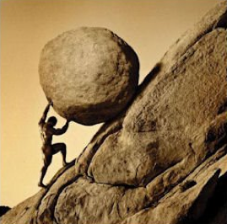
Advice for the Journey
Throughout this course, always remember to:
Work Hard!!

Slide 15
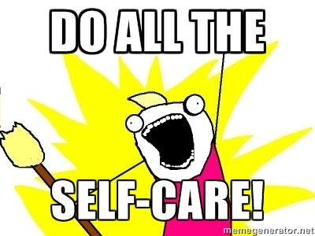
Advice for the Journey
Throughout this course, always remember to:
Work Hard!!
Appreciate your successes

Slide 16

Advice for the Journey
Throughout this course, always remember to:
Work Hard!!
Appreciate your successes
Trust yourself

Slide 17
Course Structure

Slide 18
Daily Schedule
For each class we’ll run through the following:
Set Objectives
Brief Background Lecture
Watch Me / Coding Demos
Code Discussions
In-Class Exercises
Project Work

Slide 19
Daily Schedule
For each class we’ll run through the following:
Set Objectives
Brief Background Lecture
Watch Me / Coding Demos
Code Discussions
In-Class Exercises
Project Work
The Super Important Stuff!!!
i.e. Always be coding!

Slide 20
Today’s Schedule
Students will get to know their classmates, Instructor, TA's, and Support Team.
Students will resolve any issues regarding pre-work and computer setup
Students will understand the course structure.
Students will learn common Terminal (Mac) / Git Bash (Windows) commands to set up your file and folder structures.
Students will be able to use common Terminal (Mac) / Git Bash (Windows) commands for web development.
Students will be able to set up a basic HTML document.

Slide 21
Pre-Work

Slide 22
Software Checklist
At this point, you should have each of these installed:
Slack
Sublime Text 3
Git for Version Control
Git Bash (Windows) or Terminal (Mac)
Node.js
Heroku Toolbelt
MySQL
Heidi SQL (Windows) or Sequel Pro (Mac)
Google Chrome

Slide 23
Accounts Checklist
You should also now have accounts for:
GitHub (with SSH Integration)
Heroku
LinkedIn
Stack Overflow
Twitter

Slide 24
Self-Check
Let’s do some quick checks of the following
Sublime Check
Git Bash / Terminal Check
Node Check
Git Check
Heroku Check

Slide 25
On the Modern Web

Slide 26
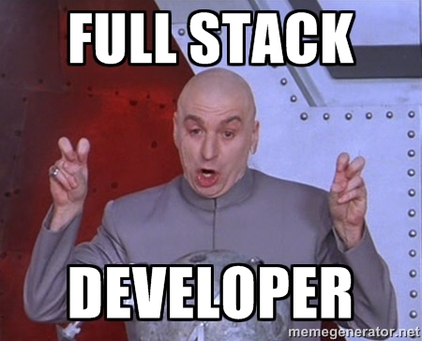
Full-Stack Development?

Slide 27

The “Magic” of YouTube

Slide 28
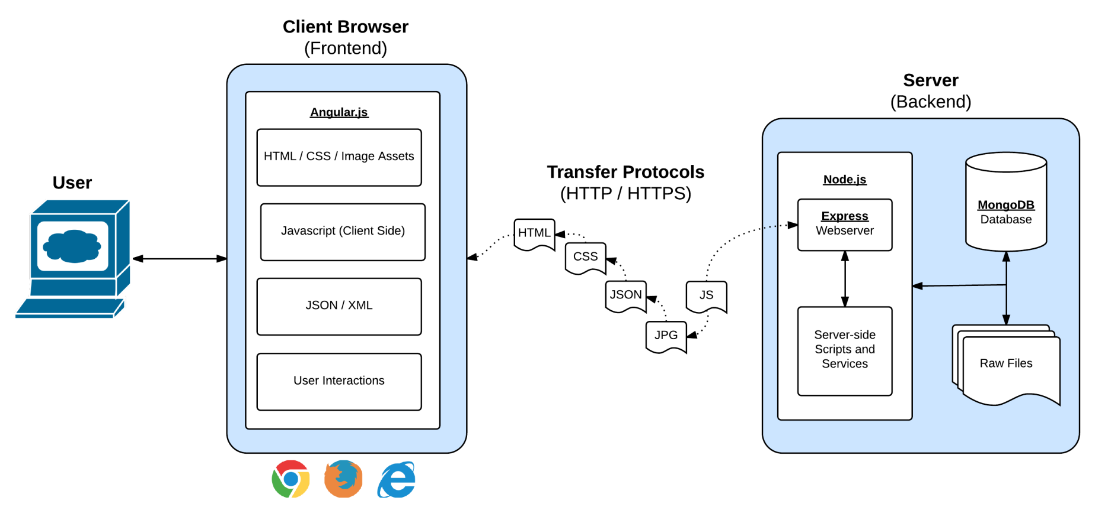
Full-Stack Development
In modern web applications there is a constant back-and-forth communication between the visuals displayed on the user’s browser (frontend) and the data and logic stored on the server (backend).

Slide 29
Full-Stack Development
Full-Stack Development is the concept of building every aspect of the web application – from the visuals and interactions, to the data transfer and processing.

Slide 30
Full-Stack Development
The Browser
Dev Tools
Middleware and Servers
HTML
CSS
Javascript
Jquery
Angular
Bootstrap
SEO
Grunt
Heroku
Git
GitHub
Constructor Functions
Templating Engines
Cookies, Sessions
Test-Driven Development Node.js
MySQL
Express.js
APIs Creating & MVC
User Authentication
Databases
MySQL
MongoDB
API Interaction
APIs (Consuming)
JSON
AJAX
Cloud DBs via Parse
Javascript Objects
CS Fundamentals
Data Structures
Sorting Algorithms
Design Patterns
Cutting Edge Development
Meteor
Laravel

Slide 31
Let’s Get Crackin!

Slide 32

Intro to Console / Terminal

Slide 33
> YOUR TURN!
Assignment:
From the Terminal / Console and using only the command line, create:
A new folder with the name of first_day_stuff
A new HTML file with the name of first_day.html
Open the current folder containing the new HTML file.
Bonus:
Create multiple directories/folders with the names one_folder and second_folder in one command.
Create multiple files with the names one.html and two.html in one command in the first_day_stuff directory.

Slide 34
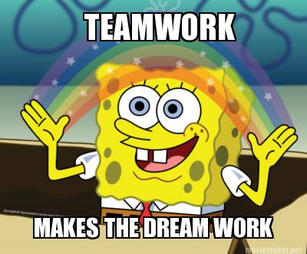
Intro to Console
Discuss with Neighbors

Slide 35
Hello, HTML

Slide 36


<title> Intro to HTML </title>
HTML is one of the three base languages behind every single website.
It defines all of the basic content and a bit of formatting.

Slide 37
> YOUR TURN
Assignment:
In a new HTML file, create the basic structure of an HTML document and include the following in it:
DOCTYPE declaration
Head tag with a title tag
H1 tag with a title of your choice
Embed an image
Create the following three links on your page:
One link that is target="_blank" so that it opens a new tab when clicked on.
Make the second link bold.
Make the third link a placeholder so it goes nowhere.
Bonus:
Create an ordered list of steps to make a sandwich.
Create an unordered list of 5 bands/musicians you like.
Create a table with 2 columns (animal class, animal name) and have 4 rows of animals
Use an alternate way of separating links without line breaks.
Embed a Youtube video of your favorite band/musician.

Slide 38
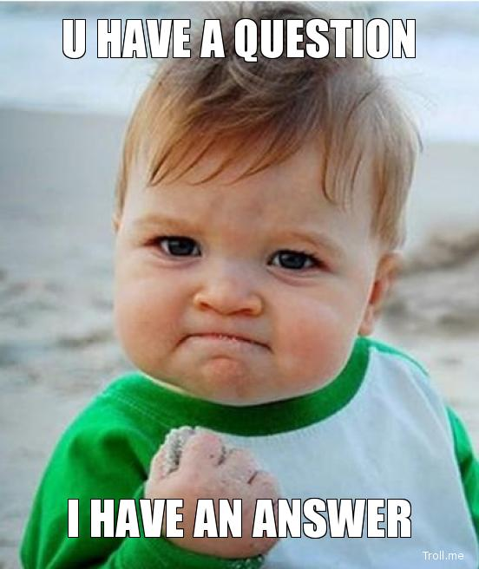
<title> Intro to HTML </title>
How’d it go?

Slide 39
Homework!

